Slide 1
The Patient Protection and Affordable Care Act (aka Obamacare): An Efficient and Equitable Path to Life, Liberty, and the Pursuit of Health? Alumni College June 17, 2016 Merton D. Finkler, Ph.D. John R. Kimberly Distinguished Professor in the American Economic System Emeritus

Slide 2
Overview of Talk
Key Provisions of the ACA
Efficiency and Equity Defined
Outcomes of Interest
Effects on Life Expectancy
Choice (health plan, providers)
Health Status
The Future – Multiple Visions
Q & A

Slide 4
PPACA: A Few Pertinent Provisions (from 900+ page document)
No exclusions for pre-existing conditions or lifetime or annual limits
Individual mandate to purchase insurance or face a tax penalty of $695+
Employer mandate to provide “affordable” insurance (<9.5% of income) if 50+ FTEs, else $2,000 penalty
Subsidized insurance through market exchanges up to 400% of the FPL and further subsidies for those with incomes between 100% and 250% of FPL
Coverage for 10 essential benefits and no out-of-pocket pay for approved preventive services
Children can be covered under a parent’s policy until age 26

Slide 5
PPACA (Continued)
Federal funding (option) of Medicaid expansion in states for those up to 138% FPL
Eligibility limited to legal, non-incarcerated residents
A variety of experiments with different payment structures including bundled payments, Accountable Care Organization (ACO) gain sharing, and incentives to reduce hospital readmissions and avoid patient harms.
Restructured Medicare Advantage and Part D plans and incentives
“Cadillac Tax” on plans with premium > $10.2k (individual)/ $27.5k (family) and review of plans w/ medical loss ratio < 80% (small group)/85% (large group)
Summary available at Kaiser Family Foundation http://kff.org/health-reform/fact-sheet/summary-of-the-affordable-care-act/

Slide 6
Essential Benefits Should Parallel Typical Employer Plan
Ambulatory patient services
Emergency services
Hospitalization
Maternity and newborn care
Mental health and substance use disorder services, including behavioral health treatment
Prescription drugs
Rehabilitative and habilitative services and devices
Laboratory services
Preventive and wellness services and chronic disease management
Pediatric services, including oral and vision care

Slide 7
Efficiency Defined
Minimized cost of delivering a prescribed set of benefits or reaching a particular set of outcomes or
Maximized set of benefits or potential outcomes from a given amount of available resources (or budget)
Efficiency cannot be judged without understanding what is to be delivered
“Cost Efficiency” is either redundant or uninformative

Slide 9
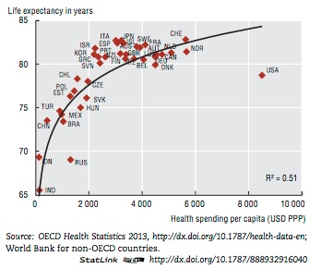
Greatest spending does not equal best outcomes

Slide 10
Uwe Reinhardt On American Conundrum
Americans have an instinctive distrust of government and have faith in private markets
Yet, Americans are unwilling to accept the harsh verdicts of markets
RESULT: “a bewildering system of half-hearted competition and half-hearted regulation”
“This approach encourages in health care an economic free-for-all in a highly imperfect market which increasingly turns patients into blind-folded shoppers thrust into a health-care shopping mall that is only haphazardly controlled by ad-hoc, often mutually inconsistent, regulations that further distort the health-care market.”

Slide 11
Notes:
Accounting for roughly 31% of expenditures in the clinical care sector ($765B)

Slide 12
The Determinants of Health
Notes:
Medical care has limited effects on the health of the population; yet we spent the vast majority of health improvement funds on clinical care.

Slide 13
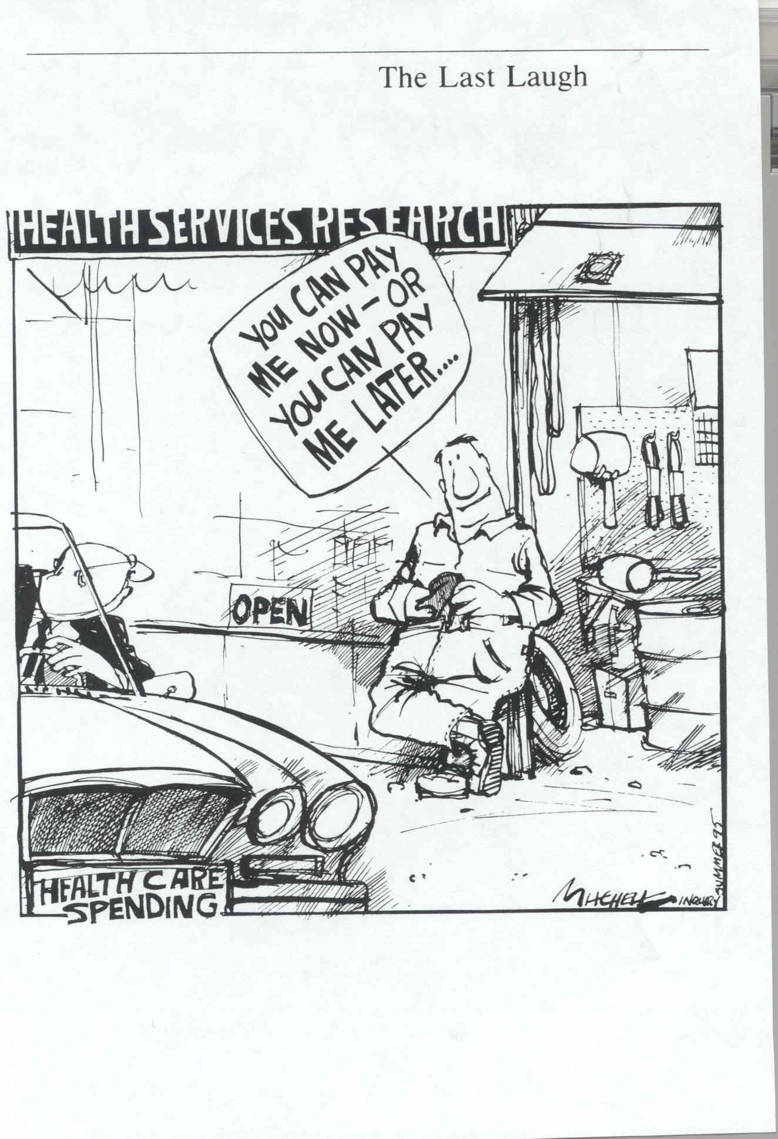

Slide 14
Equity Defined: Two Key Principles
Ability to Pay Principle
Horizontal Equity: People in similar circumstances are treated similarly – based on income, family composition & size, wealth, and health status
Vertical Equity: People who are “better off” than others should pay (at least) proportionately more than those deemed “less well off.”
Benefit Principle: Those who benefit should pay for what they receive.
Both concepts are relevant.
Notes:
Medicare and Medicaid for the former and Lasik surgery for the latter

Slide 15
Inequities in Employer Health Insurance
Notes:
Horizontal inequities also exist. People in similar circumstances may have very different health insurance depending upon whether they work for a small company or a large company and whether they have insurance or not.

Slide 16
Effects of the ACA
Cost Trends
Insurance Coverage Trends
Competition and Choice
Effects on Health

Slide 18
Or Have We?

Slide 19
Notes:
Various studies estimate the portion of the decline related to the state of the economy ranges from 37% to 75%.

Slide 20
20 Million Adults Have Gained Coverage

Slide 21
Medicaid Expansion: State by State

Slide 22
Medicaid vs. Non-Medicaid Expansion
Notes:
Medicaid expansion states started with a smaller %age of uninsured and saw that rate fall by more than the non-expansion states.

Slide 23
Health Insurance and Income Inequality
Notes:
1) Insured %, especially private, rises with income and 2) Change from 2012-2014 matters for the bottom 70%+.

Slide 24
Competition and Choice Market Exchanges for Health Plans
Job Lock – No longer a critical factor
https://www.healthcare.gov/search/?q=health%20plans
Withdrawal of United Health Care – limited effect on competition / premiums (Note: UHC did not participate in 2014)
Premiums and administrative costs for individual health plans are lower inside exchanges than outside.
Bronze plans leave large out-of-pocket expenses for enrollees. Hospitals are having trouble collecting; thus, many are not accepting bronze coverage.
32% of those eligible for market place have participated (December 31, 2015)

Slide 25
Notes:
KFF analysis

Slide 27
Exchange Market Stability
Rates and degree of competition have varied a great deal both across 2014-2016 and across markets
2017 Rates: 2nd lowest price silver plan projected to ↑ by 10% -average – some plan switching will take place. With subsidies (80%) and those switching (between 40 and 50% each year)- ↑4%
Many insurers have lost money in particular markets and are either dropping out or raising premiums. (United Health Care and Humana)
ACA reinsurance payments of $20B was temporary (↑4% to 7% effect)
No reason to believe that exchange markets will self-destruct

Slide 30
Effects on Health
Oregon Study on Medicaid
Randomized control trial generated no significant improvements in health over 1st 2 yrs.
Increased use of health care services, rates of diabetes detection & management, lower rates of depression and reduced financial stress.
Waiver provisions within the ACA enable states to move $ upstream to primary prevention (with reduced Disproportionate Share payments)
Changes in incentives, especially regarding reduced Medicare payment for hospital acquired conditions and re-admissions w/in 30 days. There exists some debate about the effects on hospitals that serve low income people.

Slide 31
Effects of Insurance on Chronic Disease
Notes:
Hogan et al., Health Affairs Sept 2015

Slide 32
Quality of Hospital Care Has Improved
Notes:
CEA slides on ACA after 6 years. Also readmission rates have fallen.

Slide 33
Life, Liberty, and the Pursuit of Health
Effects on life expectancy are not yet discernable. To the degree resources are moved “upstream” from intensive medicine, life expectancy will improve. - Too early to tell
The penalty for not purchasing insurance or purchasing “bare bones” insurance has increased markedly; however, within both the government run exchanges and private exchanges, choice of plan benefits and provider networks has expanded – especially in urban areas – It depends upon what one means by liberty or optimal choice. (OPM)
We have yet to make serious headway in reallocating resources to where they have the greatest influence on health improvement. – Improved potential related to treating chronic disease but too early to tell.
Notes:
Camden, NJ example

Slide 34
Different Goals, Different Means
Republicans – promote consumer choice, reduce market regulation, reduce federal spending, and reduce role for the federal government
Democrats – expand coverage, strengthen consumer protections through governmental regulation, and control of the cost of health care through regulated markets
Clinton – defend and build on the ACA
Correct flaws (such as “the family glitch”), fill gaps (those not insured or with large out-of-pocket burdens), and find ways to reward value and quality.
Trump – attempt to increase consumer choice and competition
Expand deductibility of insurance, increase price transparency, reduce barriers to entry for Rx, and institute block grant Medicaid

Slide 35
Is This the Beginning of the End or the End of the Beginning for the ACA?
Total repeal will not take place – though extensive reform might take place. Key benefits will remain. Financing might change.
Move beyond administrative challenges that faced ACA implementation to development of stable markets for individual plans based on a diversified risk pool, local market competition, and a focus on quality of care and service rather than just on premium
Early search for market share (through relatively low premiums) replace by premium hikes and much entry and exit
Improved information and consumer experience will evolve with insurers better understanding desired and sustainable health plans.
Notes:
End of the beginning.

Slide 36
Thank You For Listening

